Slide 1

FAKE NEWS DETECTION
SHASHI SAHU
BATCH -30
SME- MOHD. KASHIF SIR

Slide 2
Business Problem Framing
Need to classify if a news is fake or not, based on the Author’s name, Headline and the actual content of the article.
The authenticity of Information has become a longstanding issue affecting businesses and society, both for printed and digital media.
On social networks, the reach and effects of information spread occur at such a fast pace and so amplified that distorted, inaccurate, or false information acquires a tremendous potential to cause real-world impacts, within minutes, for millions of users.
Recently, several public concerns about this problem and some approaches to mitigate the problem were expressed

Slide 3
Data- Description:
You can find many datasets for fake news detection on Kaggle or many other sites. I download these datasets from Kaggle. There are two datasets one for fake news and one for true news. In true news, there is 21417 news, and in fake news, there is 23481 news. You have to insert one label column zero for fake news and one for true news.

Slide 4
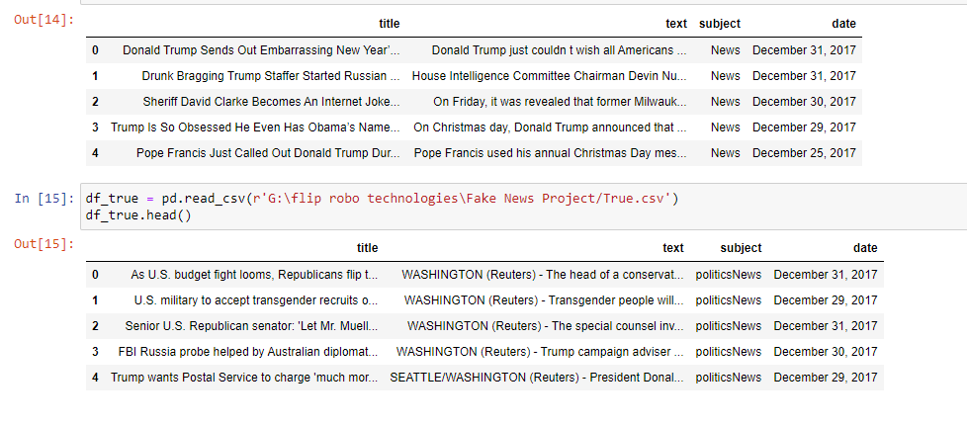
Dataset
The figure shows how the given dataset looks like

Slide 5
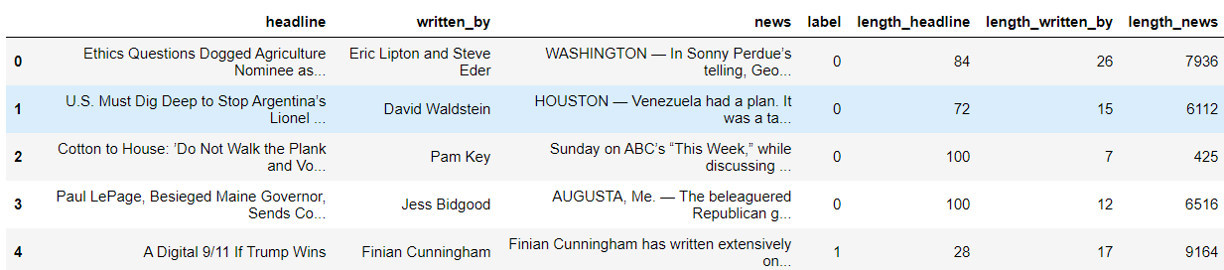
Calculated Lengths of Features

Slide 6
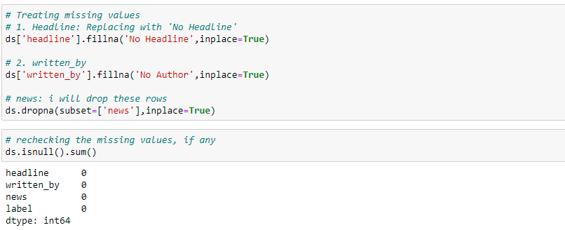
HANDLING MISSING VALUES

Slide 7
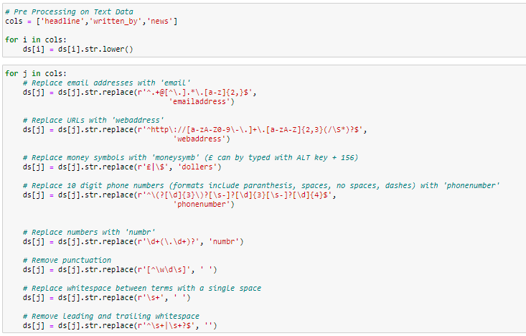
Using NLP to Solve Problem
Here the idea is to vectorize the contents so that the meaning of the article can be understood by the machine. The following pre-processing steps were done:

Slide 8
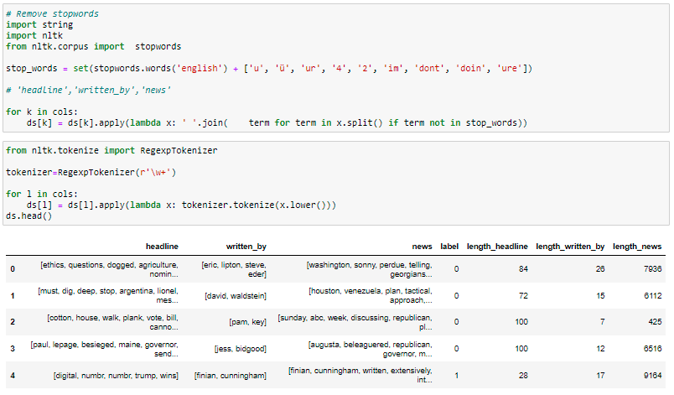
Stop Words Removal
We need to remove words like for, of, the etc. which do not actually add to the context so that our processing speed is reduced

Slide 9
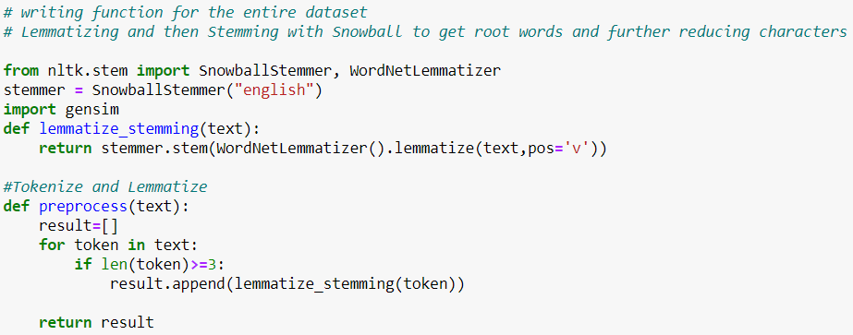
I have performed lemmatization and stemming on the features – Headline and news. This is done to find the root words.

Slide 10
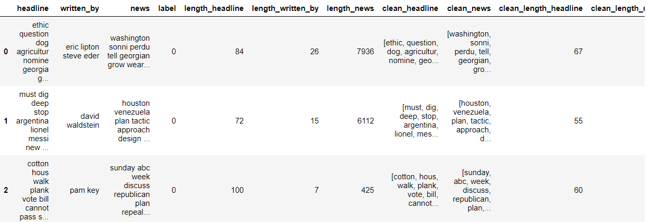
Finally, we can see the counts of actual data and data after pre-processing

Slide 11
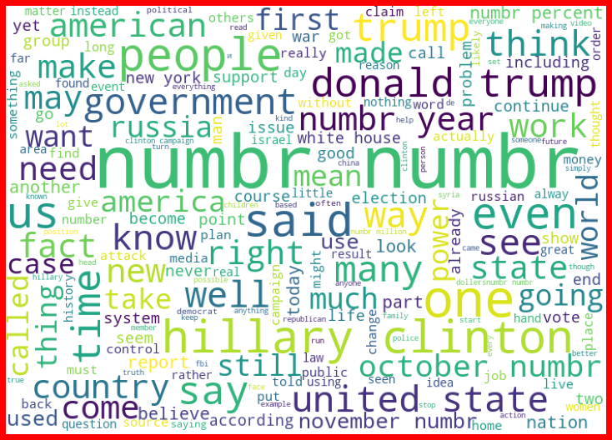
Word Cloud for Fake News for News Column

Slide 12
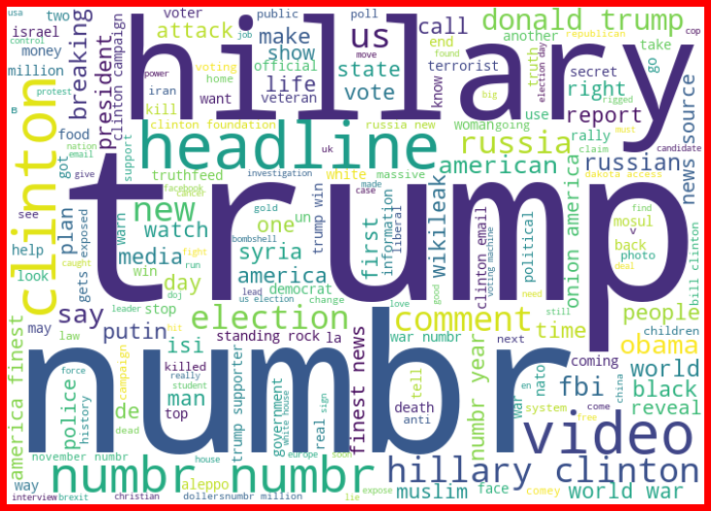
Word Cloud for Fake News for Headline Column

Slide 13
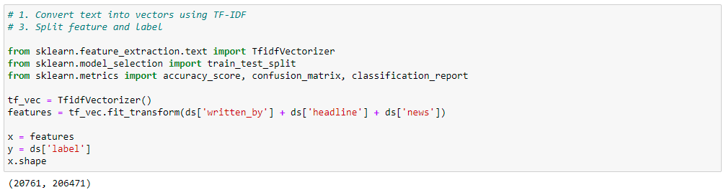
Next, I have vectorized using tf-idf vectorizer so that words are arranged in a 2-d area based on similarity or difference in their meaning.
Also, prepared X and y variables for model building

Slide 14
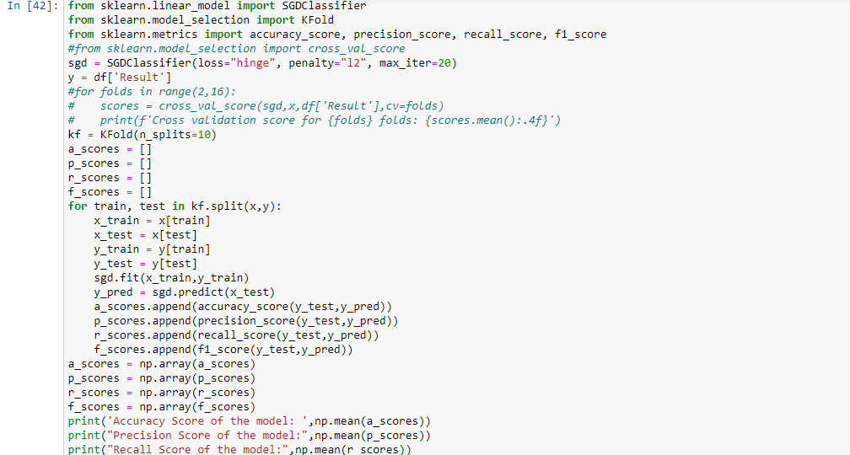
Let’s have a look at the Model Performances

Slide 15
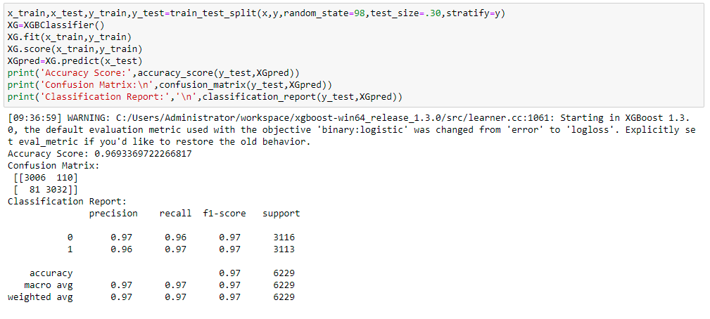
Final Model

Slide 16
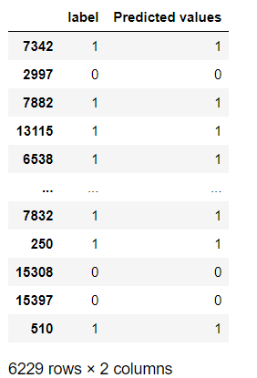
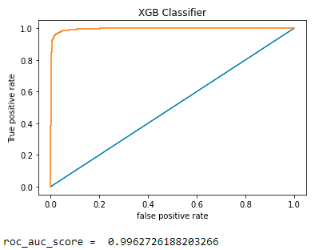
Roc Auc Score and Predicted Values

Slide 17
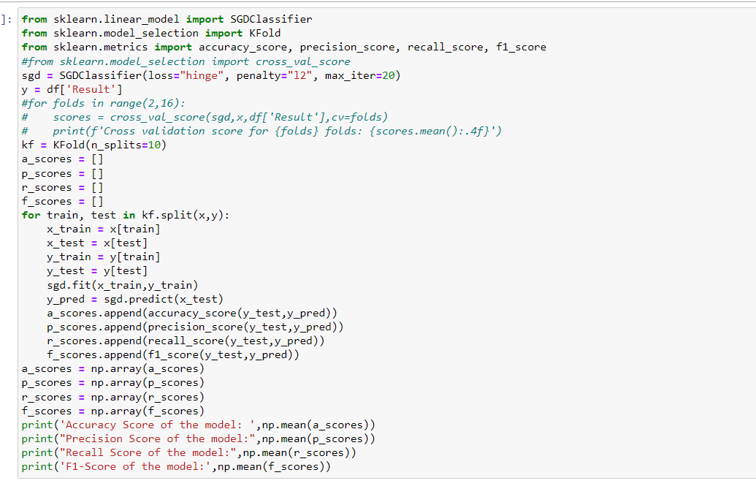

Fitting it into ML Model (Neural Networks - Schocastic Gradient Descent) and Calculating its Accuracy

Slide 18

Conclusion - Fake news detection model has been made successfully with accuracy of 98.99%.

